Slide 1
Transportation and COVID
Trevor McLemore

Slide 2
Do transportation infrastructure and type of commute effect the amount of COVID cases and deaths?

Slide 3
Data Sources:
County Transportation Profiles
Catalog.data.gov csv updated 03 Aug 2020
USA Facts Corona Virus Cases and Deaths
Usafacts.org csvs updated daily (pulled on 26 Oct 2020)
County Adjacency File
Census.gov txt updated 2010
County Demographic Data (didn’t end up using)
Ipums.org csv can choose any census date, or variable
Airport Enplanement Data (didn’t end up using)
FAA.gov csv updated 29 Oct 2020

Slide 4
Dependent Variables Explored:
Cases per million
Deaths per million
Independent Variables Explored:
Neighboring county cases per million
Neighboring county deaths per million
Business density
Fraction of residents working
Fraction of workers working from home
Fraction of resident workers commuting by transit
Workers commuting in from other counties as a fraction of that county’s workforce
Fraction of workers commuting out
Fraction of resident workers commuting within the county
Number of Docks

Slide 5
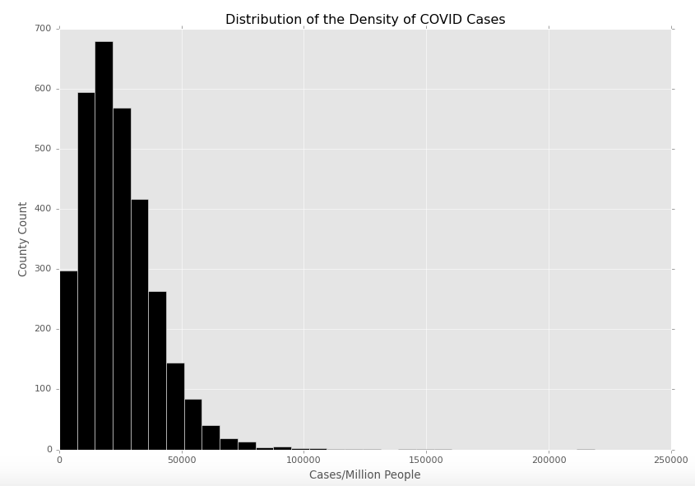
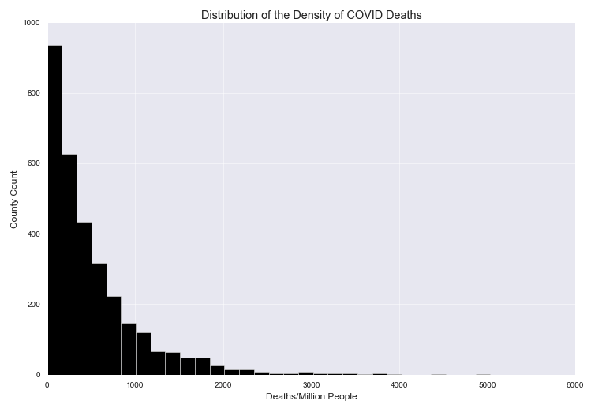
Can we Use a Welch T Test to test the difference in cases, or deaths between counties?
No, looks like Poisson; Not a Normal
No, looks like Exponential Decay; Not a Normal

Slide 6
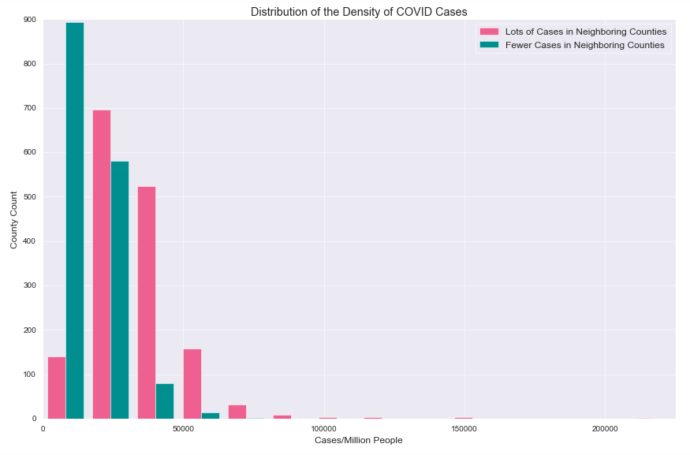
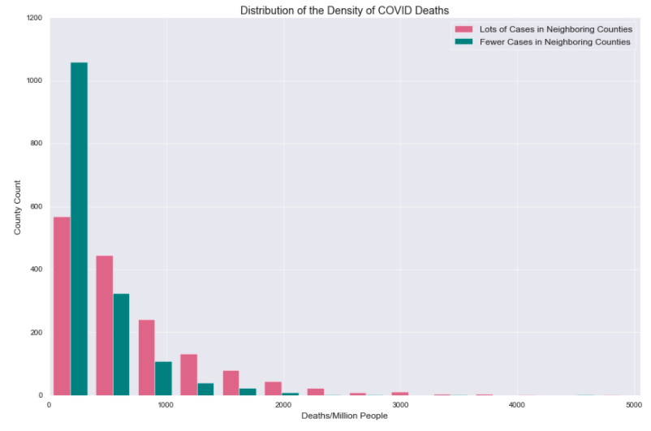
H0: The density of cases/deaths is no different if the neighboring counties have more, or fewer cases. (alpha = 0.05)
p=3.28 x 10**-265
33288 Mean COVID cases for high neighboring county case group
15831 Mean COVID cases for low neighboring county case group
p=9.17 x 10**-90
693 Mean COVID deaths for high neighboring county case group
331 Mean COVID deaths for low neighboring county case group

Slide 7
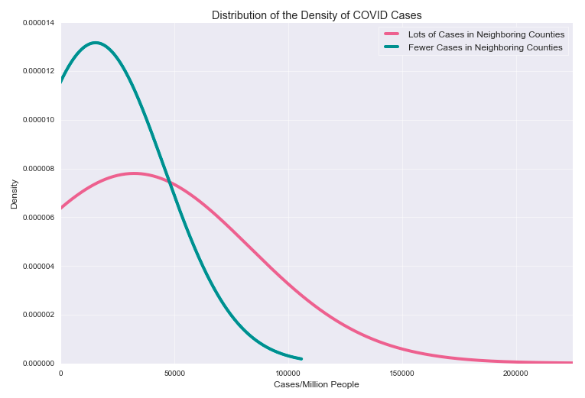
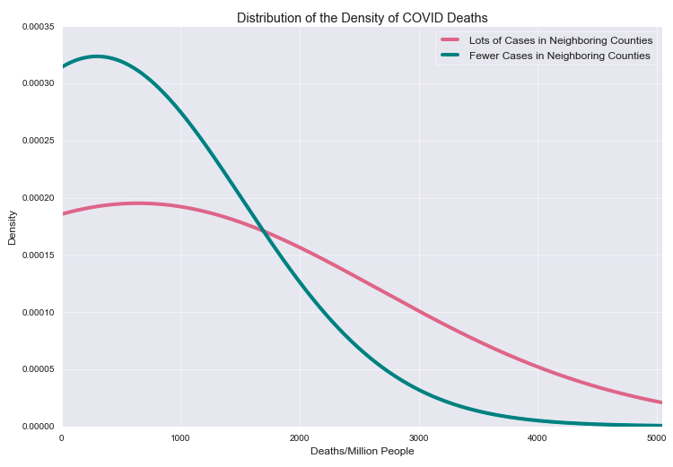
It’s clearly better to have fewer cases in neighboring counties.
The high group has on avg 17457 more cases per county
The high group has on avg 210 percent as many cases as the low group
The high group has on avg 362 more deaths per county
The high group has on avg 209 percent as many deaths as the low group

Slide 8
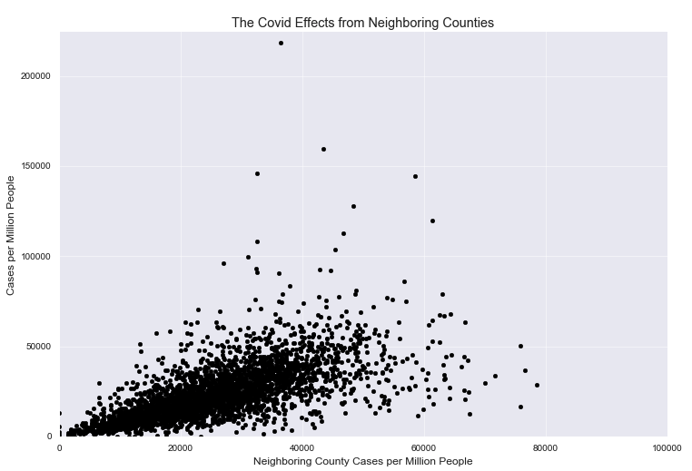
Heteroskedasticity: Higher variance for higher counts of neighboring cases.

Slide 9
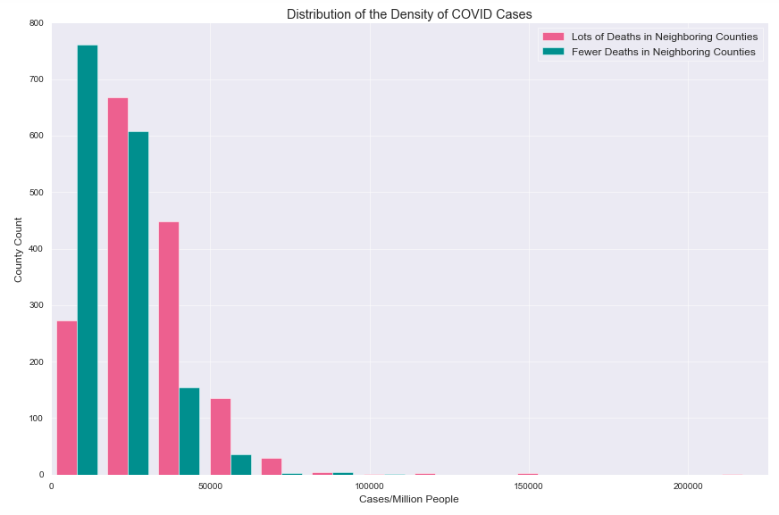
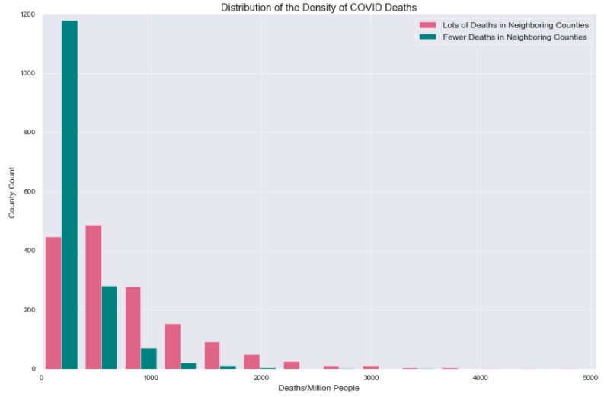
H0: The density of cases/deaths is no different if the neighboring counties have more, or fewer deaths. (alpha = 0.05)
p=2.71 x 10**-110
30273 Mean COVID cases for high neighboring county deaths group
18847 Mean COVID cases for low neighboring county deaths group
p=4.15 x 10**-181
763 Mean COVID deaths for high neighboring county deaths group
261 Mean COVID deaths for low neighboring county deaths group

Slide 10
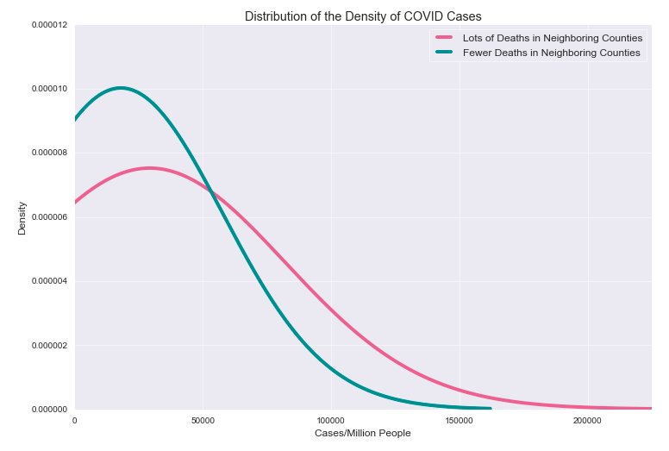
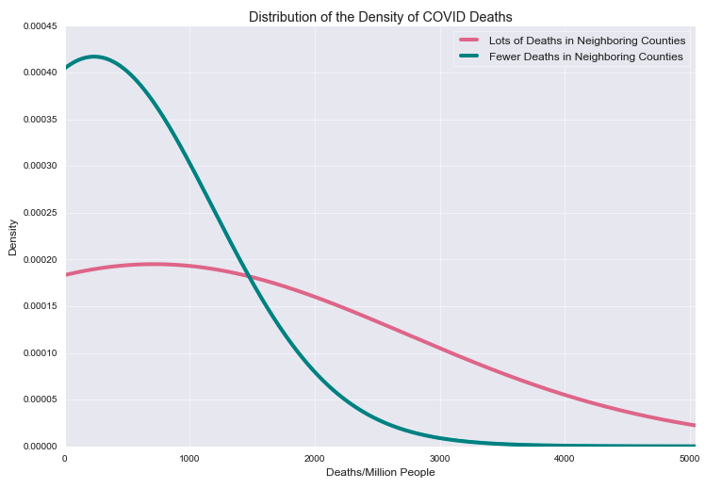
It’s clearly better to have fewer deaths in neighboring counties. I expected neighboring cases to have as strong an effect on deaths, but was wrong
The high group has on avg 11426 more cases per county
The high group has on avg 161 percent as many cases as the low group
The high group has on avg 502 more deaths per county
The high group has on avg 292 percent as many deaths as the low group

Slide 11
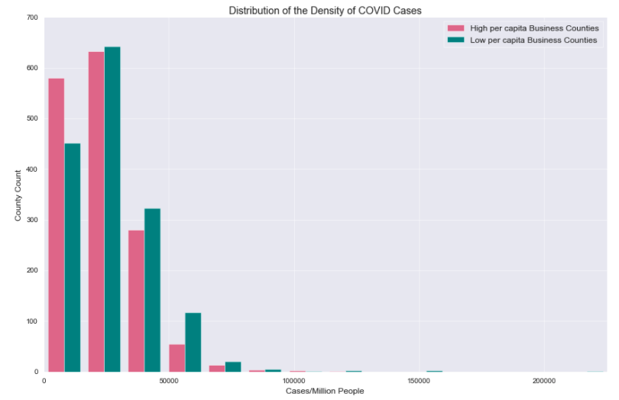
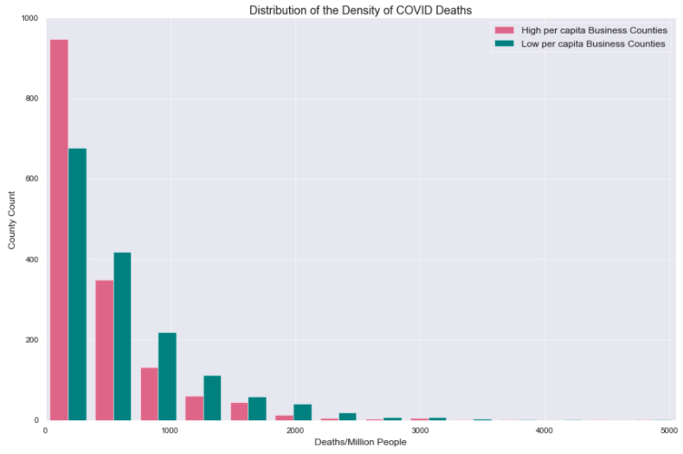
H0: The density of cases/deaths is no different if the neighboring counties have more, or fewer businesses per capita. (alpha = 0.05)
p=1.47 x 10**-11
22638 Mean COVID cases for high business per capita group
26517 Mean COVID cases for low business per capita group
p=1.76 x 10**-29
420 Mean COVID deaths for high business per capita group
606 Mean COVID deaths for low business per capita group

Slide 12
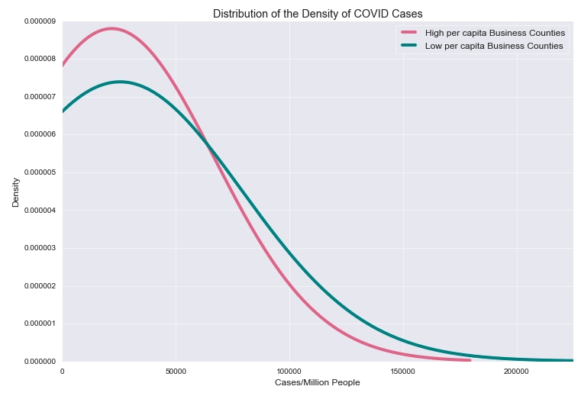
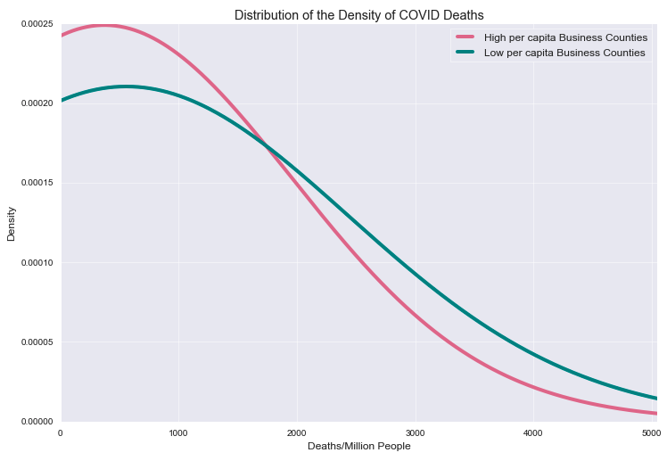
It’s better to have more businesses per capita. Especially safeguarding against deaths. I suspect that’s demographic related (not iid).
The high group has on avg 3879 less cases per county
The high group has on avg 85 percent as many cases as the low group
The high group has on avg 186 less deaths per county
The high group has on avg 69 percent as many deaths as the low group

Slide 13
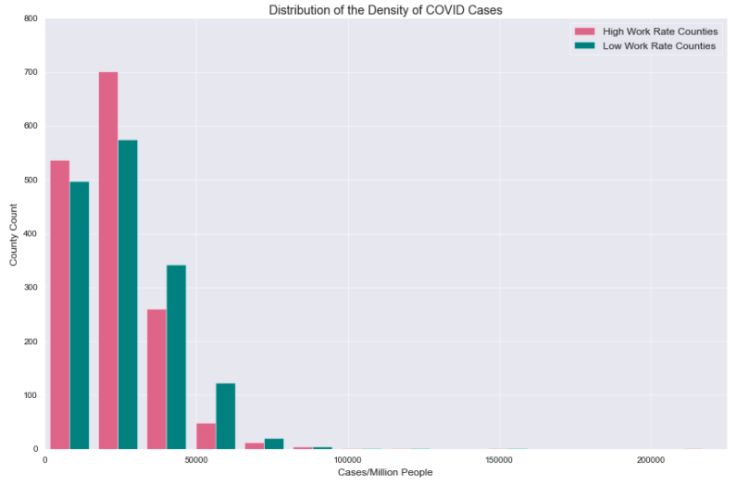
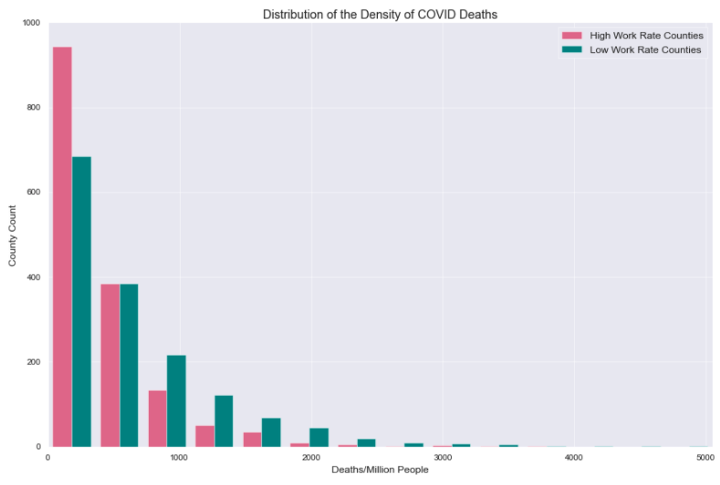
H0: The density of cases/deaths is no different if the neighboring counties have more, or fewer the residents working. (alpha = 0.05)
p=2.22 x 10**-6
23094 Mean COVID cases for high employment group
26031 Mean COVID cases for low employment group
p=3.40 x 10**-24
402 Mean COVID deaths for high employment group
622 Mean COVID deaths for low employment group

Slide 14
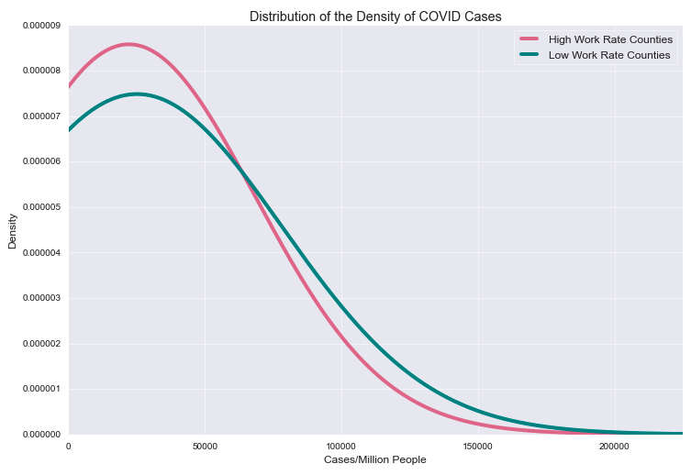
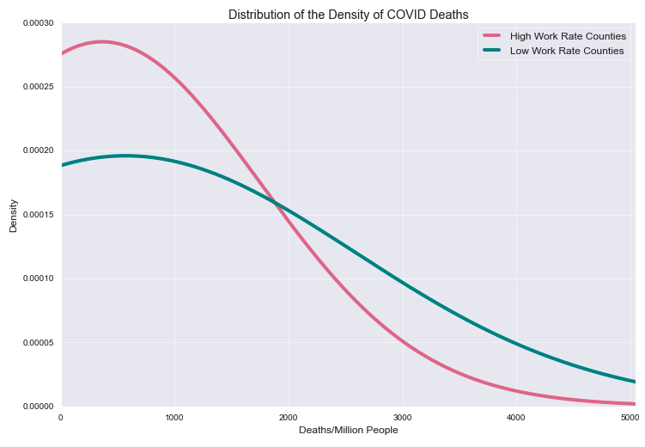
It’s better to be employed. We’re almost certainly capturing wealth effects from omitted variables.
The high group has on avg 2937 less cases per county
The high group has on avg 89 percent as many cases as the low group
The high group has on avg 220 less deaths per county
The high group has on avg 65 percent as many deaths as the low group

Slide 15
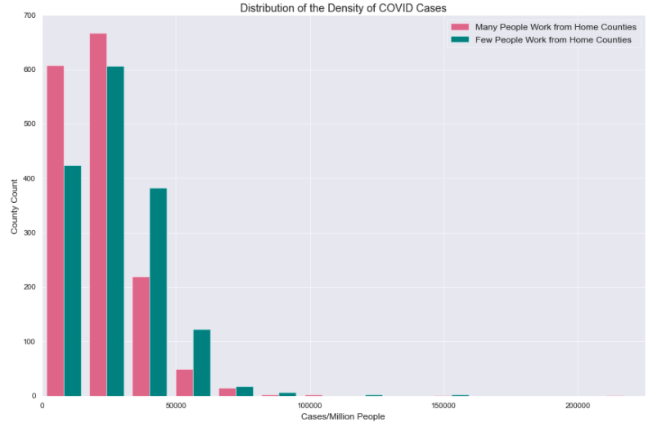
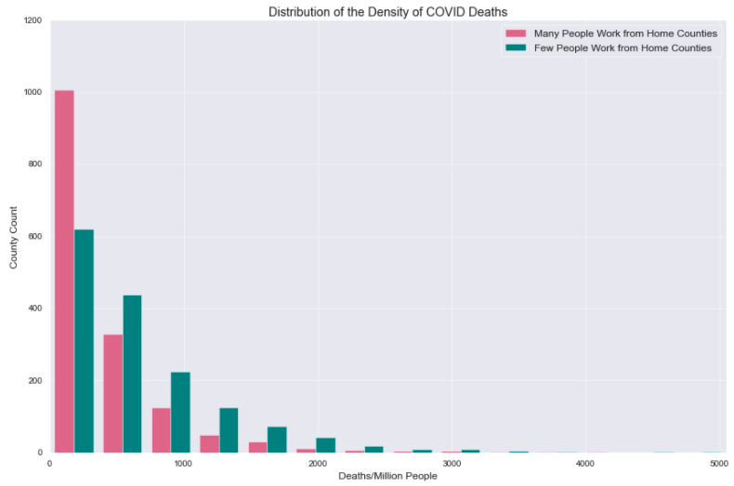
H0: The density of cases/deaths is no different if the neighboring counties have more, or fewer of working people working from home. (alpha = 0.05)
p=6.59 x 10**-27
21785 Mean COVID cases for high work from home group
27358 Mean COVID cases for low work from home group
p=6.60 x 10**-57
327 Mean COVID deaths for high work from home group
646 Mean COVID deaths for low work from home group

Slide 16
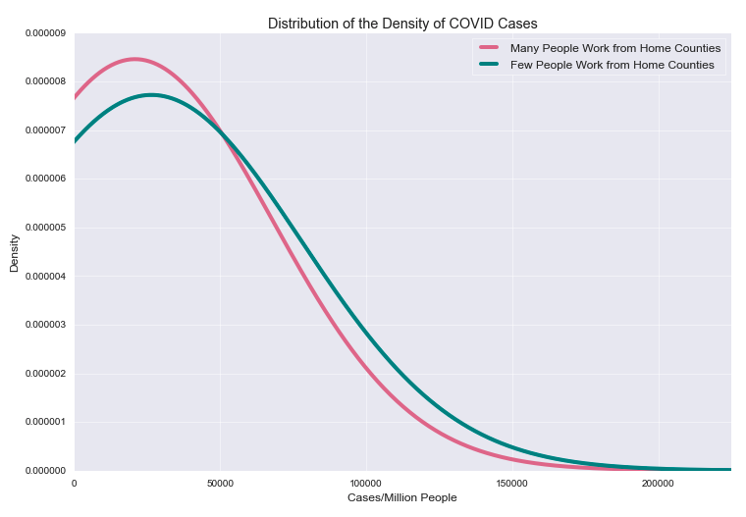
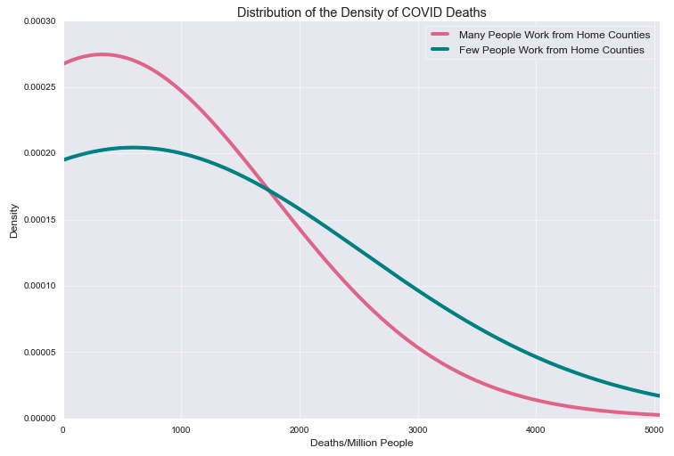
It’s better to have a higher fraction of people working from home. The impact is much bigger protecting against death (maybe testing is inadequate?)
The high group has on avg 5573 less cases per county
The high group has on avg 80 percent as many cases as the low group
The high group has on avg 319 less deaths per county
The high group has on avg 51 percent as many deaths as the low group

Slide 17
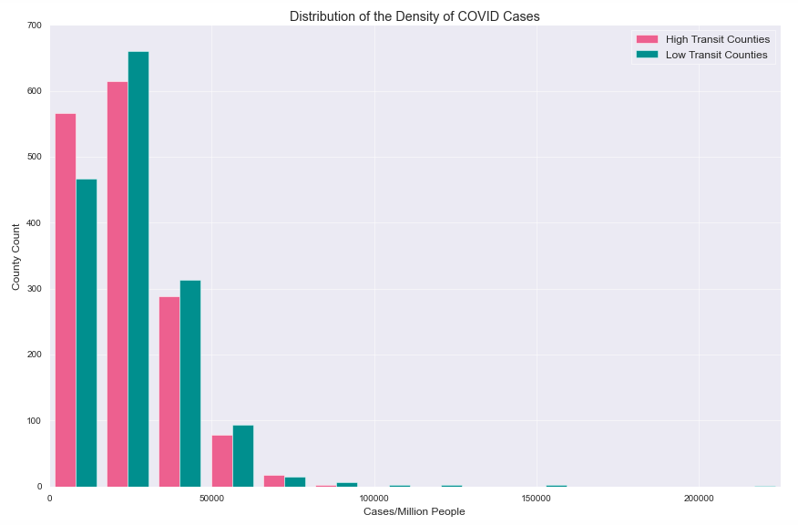
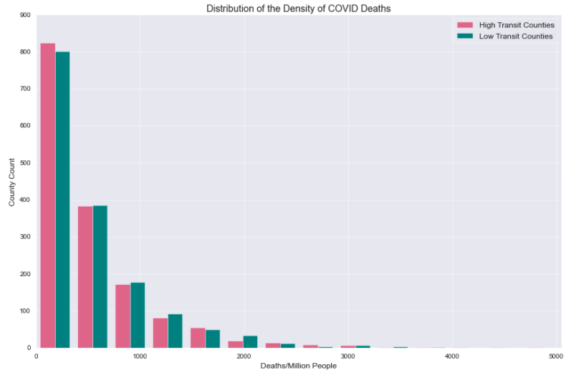
H0: The density of cases/deaths is no different if the neighboring counties have more, or fewer of working people taking public transit. (alpha = 0.05)
p=5.24 x 10**-6
23247 Mean COVID cases for high public transit group
25878 Mean COVID cases for low public transit group
p=0.388 (can’t reject)
508 Mean COVID deaths for high public transit group
516 Mean COVID deaths for low public transit group

Slide 18
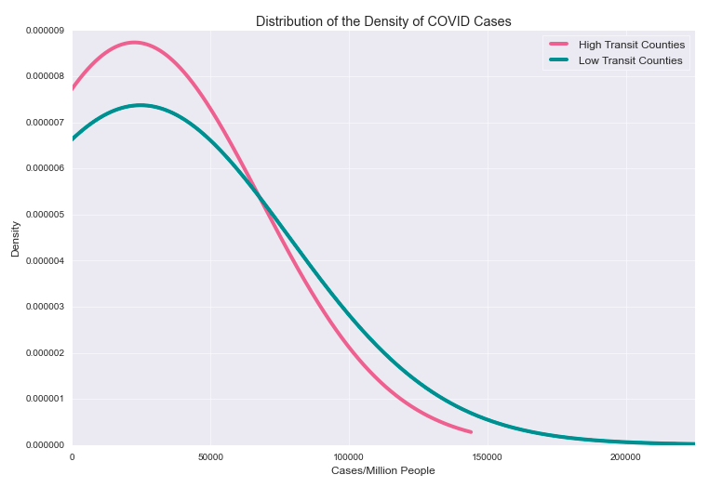
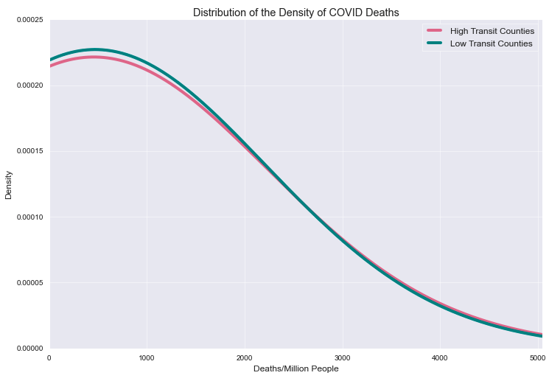
Higher public transit counties spread COVID slightly less (counterintuitive) This could be demographic related or maybe public transit takes steps to prevent spread and increase tests where a rideshare culture doesn’t.
The high group has on avg 2631 less cases per county
The high group has on avg 90 percent as many cases as the low group
NOT SIGNIFICANT: The high group has on avg 8 less deaths per county
The high group has on avg 98 percent as many deaths as the low group

Slide 19
Data Considerations:
Case variable has very uneven testing between Mar and Jul
Policy reactions change commuting behaviors and risks (not identically distributed)
Some variables had highly dependent reactions in both directions such as case density in neighboring counties
Essentially all my results were EDA. Requires further evaluation and controls.

Slide 20
Further Research:
The enplanement data (airport traffic and connections)
Demographic buckets to establish links between cases and deaths
Time series (delayed effects of deaths, Bayesian updating, etc)
Regressions and interactions
Did I answer the effect of transportation infrastructure and type of commute on COVID cases?
No, but I have better, more targeted questions

